Slide 1
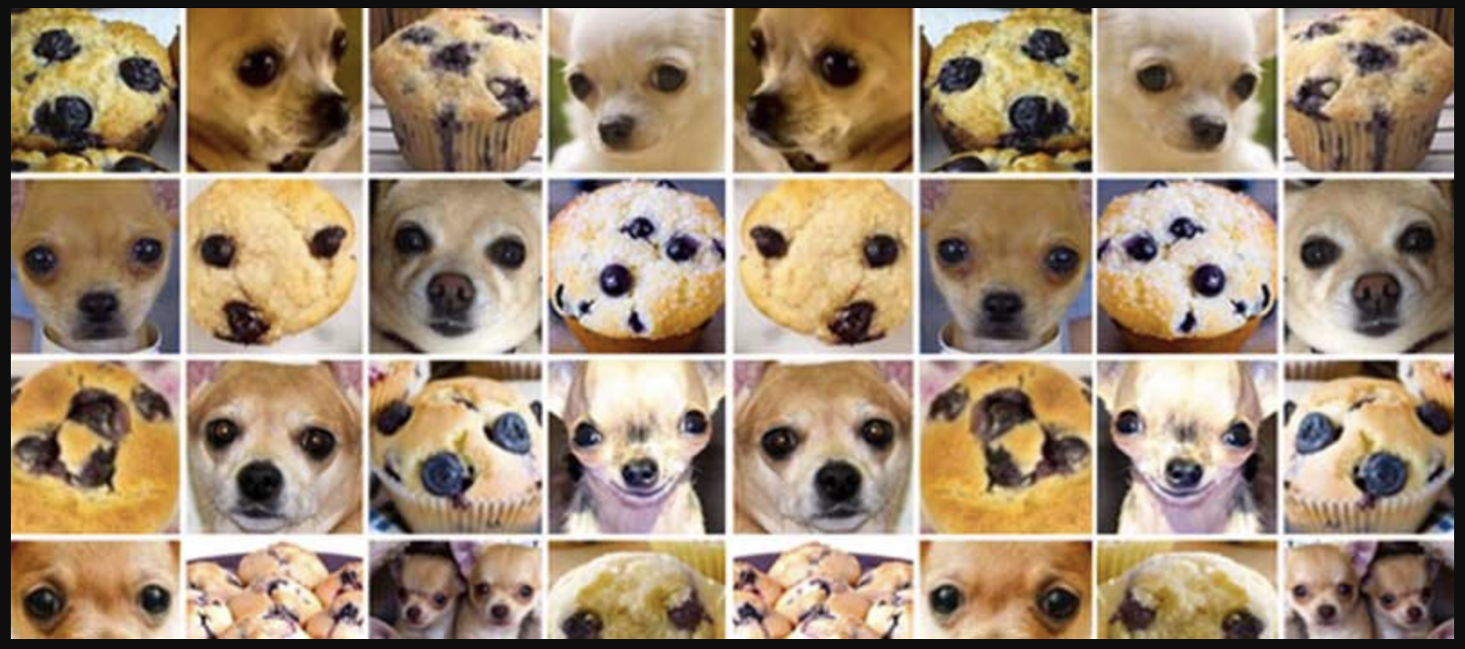
Dog Breed Categorization
By: A_PERM

Slide 2
Project Objective & Approach
Objective
To create a platform for users to submit an image of a dog and have the model return the breed of that dog.
Approach
The Convolution Deep Learning model that will correctly predict the breed of the dog with at least an 80% validation accuracy level.
Create a web app to present the results with the breed name alongside some basic information.
Notes:
We l also included a table under the prediction which will allow the user to search the predicted breed type to gain more information on that particular dog breed.(provided by a JSON file created from the akc-data-latest.csv)
*****I edited this since we didn’t end up using a database, we were able to generate the dog information table using a JSON file created from the akc-data-latest.csv and modified to only include the breed types used for training and testing data****
Create a Convolutional Deep Learning model for the Dog’s Breed Identification
Create a database that can be accessed to give the user more information on the breed .
Create a web app to show the results with the breed name along with some basic information.

Slide 3
Data Sources:
Images of 113 different dog breeds with multiple images per breed type provided by:
https://www.kaggle.com/datasets/jessicali9530/stanford-dogs-dataset
A csv file listing all the different dog breeds and their attributes
akc-data-latest.csv
Downloaded from the following GitHub profile:
https://github.com/tmfilho/akcdata
License for the data: https://github.com/tmfilho/akcdata/blob/master/LICENSE

Slide 4
STEPS
Parse the Dataset file
Preprocessing the data:
starting with 8 breeds and as we moved further, added more to train and test the data
Train and test the sets :
used 80/20 train test split
Adjust the model with various weights, neurons, and activation functions
The model was altered by:
Adding dense layers to see if it had a noticeable effect
Using data augmentation to see its effect
Using both dense layers and data augmentation to see its effect
Create a JSON file with breed information from akc-data-latest.csv
Create a webpage with 3 pages that can be easily navigated by the user
Connect the machine learning model to the web page

Slide 5
Model Process
Data pre-processing
Building the model
Training the model
Decide on final model
Evaluation of final model
Predicting on the test set
Saving the trained model
Loading the trained model for use elsewhere

Slide 6
Data pre-processing
Label encoding: getting the label for each image based on the folder it’s found in
Image resizing: 224x224 chosen as our standard size
Array scaling: turning each image into a 2-D array where each spot in the array corresponds to a pixel in the image, transforming RGB tuples to be between 0 and 1

Slide 7
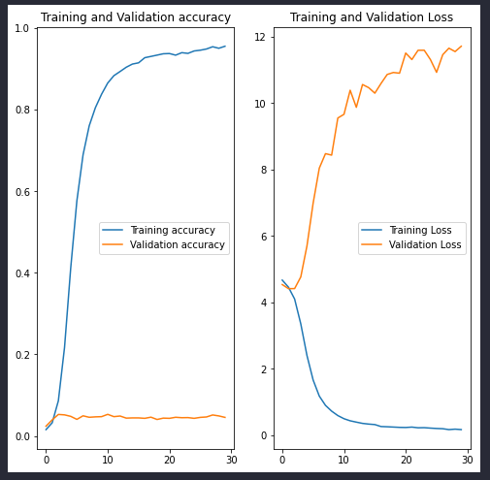
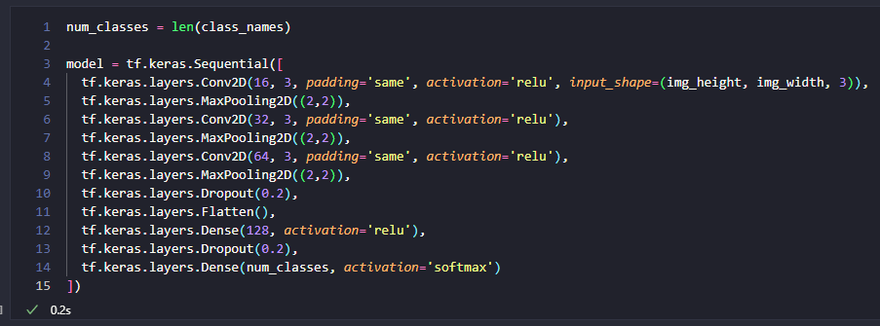
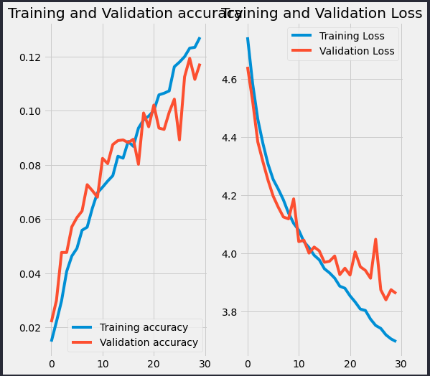
Building a Model
Research showed the Convolutional Neural Networks (CNN) were a standard first approach for image classification problems.
We attempted to build one by hand, and found out we’d get nowhere quickly trying to get something as complicated as breed identification off the ground on our own graphics cards.

Slide 8
Transfer Learning
We ended up using a Transfer Learning model built out with a Convolutional Neural Network to classify our images. With this we can take a model trained on millions of images for general classification, and then add in our data for the last few layers to get a more specific classification.

Slide 9
Model Selection
Many different transfer learning models are available on Tensorflow Hub, we wanted to test five models to see what would give us the most accuracy when introduced to our photos.
mobilenet_v2 = "https://tfhub.dev/google/imagenet/mobilenet_v2_130_224/classification/5"
mobilenet_v3 = "https://tfhub.dev/google/imagenet/mobilenet_v3_large_100_224/classification/5"
inception_v3 = "https://tfhub.dev/google/imagenet/inception_v3/classification/5"
efficientnet_v2 = "https://tfhub.dev/google/imagenet/efficientnet_v2_imagenet1k_b0/classification/2"
resnet = "https://tfhub.dev/tensorflow/resnet_50/classification/1"

Slide 10
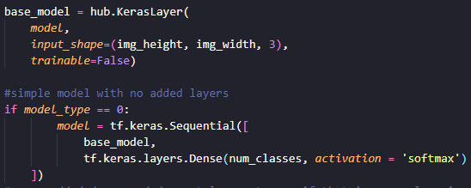
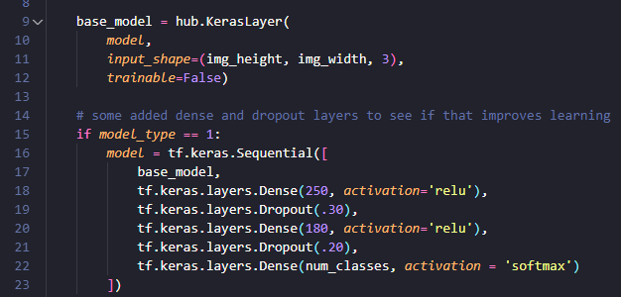
Model Selection
With these models we created several cases to see what kind of performance they would bring in different scenarios.
The first case was a simple model with the TF HUB model feeding directly into a predictions layer.
The second case had additional dense layers added to increase learning with the output from the TF HUB model. We also added in Dropout layers to help deal with overfitting.

Slide 11
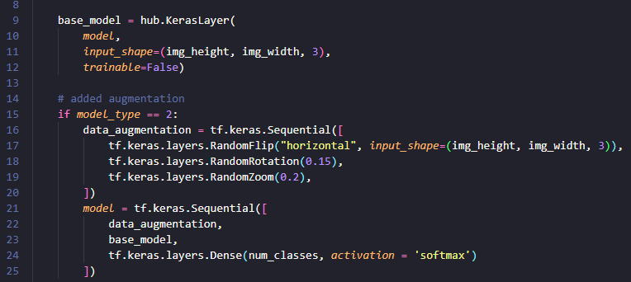
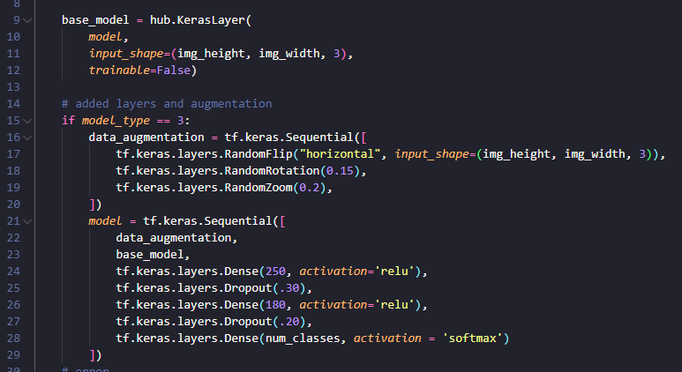
Model Selection
The third case added data augmentation to increase the number of photos that the model could train from.
The fourth and final case added both extra layers and data augmentation. Since this was a resource-intensive case we only ran it once we knew which parent model we were going to go with.

Slide 12
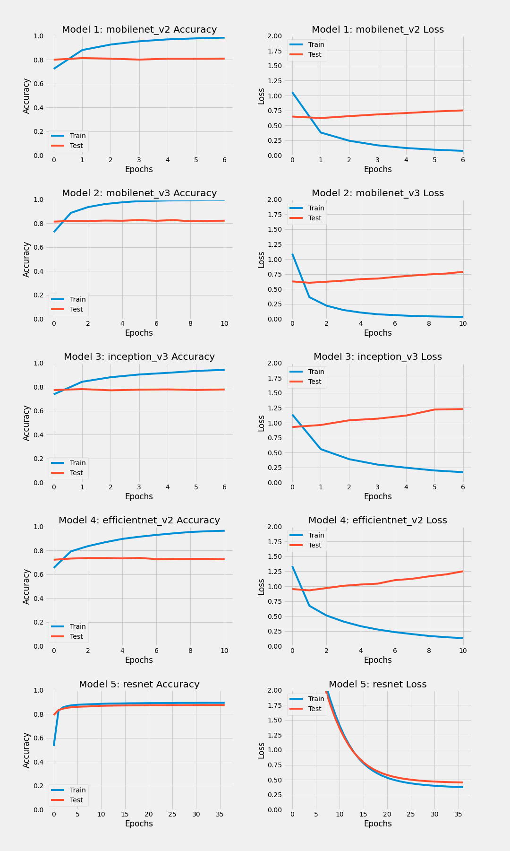
Model Selection - Base Case Results

Slide 13
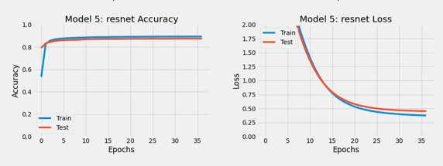
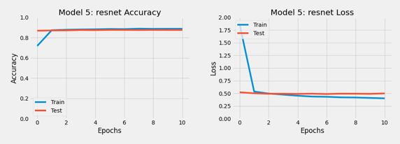
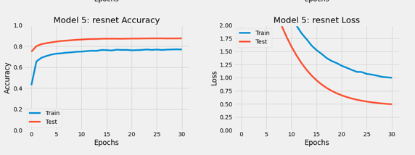
Resnet is the winner!
base_model
add_layers
with_augmentation

Slide 14
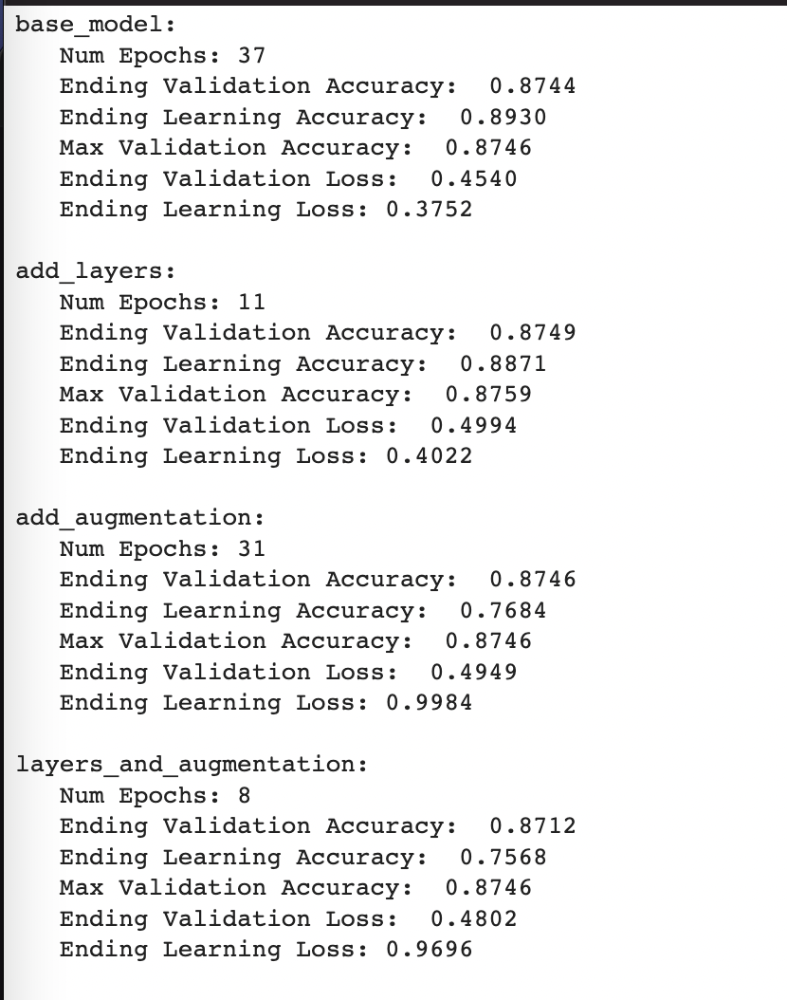
Machine Learning Algorithm
The final model chosen was the “add_layers” model. This does not have data augmentation, but does include Dense layers after the Transfer Learning Models. This needed only 11 epochs, while keeping the learning and validation accuracies high and close to one another. It also avoided overfitting and saw low losses.

Slide 15
Model Outcome
We were aiming to be able to predict the breed from an image using the trained model with around 80% accuracy.
The model we have chosen was able to achieve a validation accuracy above the required limit, achieving 87% validation accuracy.
There does seem to be a limitation with the model, in that it does best with purebred dogs rather than dogs who are mixed breed.

Slide 16
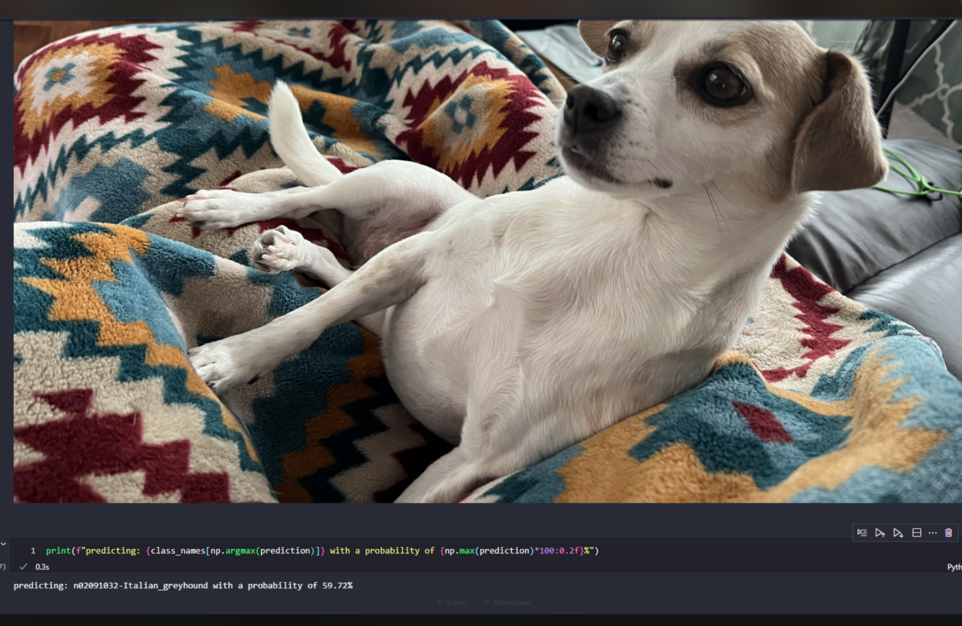
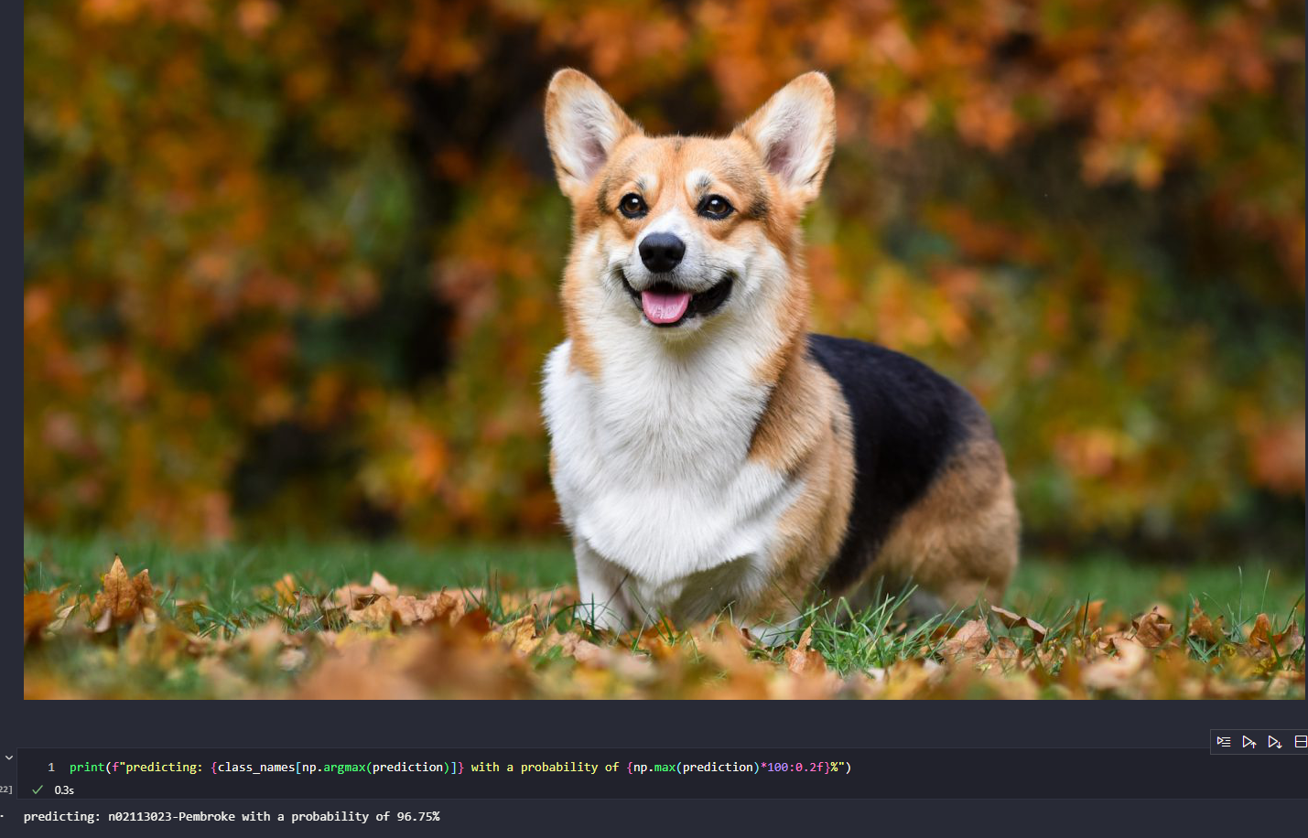
Model Results
Predicted Pembroke Corgi with 96.75% confidence
Predicted Italian Greyhound with 59.72% confidence

Slide 17
User Interface and Model Deployment
Website Design
Flask app
Web hosting services

Slide 18
Website Design
Create a Blueprint for Website
Three pages: Main page, Breed Results page, About us page
Main Page
Includes a brief explanation of our purpose.
A button that takes the user to the upload section.
The Power point with a more indepth look at our work
Breed Results page
This page includes an upload section
It will return its estimation on the breed here
The user can then use the drop down menu to gain more information about that breed or any other in the set
About Us page
This page includes each team mate and a brief description
Notes:
Our website consists of 3 pages, our initial page explains our purpose and provides a button to the page where the user can upload an image of their dog. Here the model will take the uploaded image and display the uploaded image, in the table below it will then display information on the breed which the model has identified. The final page includes the creators of the project, a brief bio, and the model estimated breed by the model. Web page design were pulled from css documentation and altered to fit the design concepts for our website.

Slide 19
Process
Construct the web pages
Alter the dataset to be used as a JSON file
Remove a number of breeds
Remove unneeded columns
Convert it to a JSON file
Create a table
Create code to pull from the JSON file
Display it in the table
Connect the ML model to the Web page
Use python in flask app
Deploy the Web Page
Attempted to host our flask app through Heroku
Attempted to host our flask app through GoDaddy
Final solution: host flask app through private virtual machine

Slide 20
Conclusion
Success:
Purebred vs Mixed Breed
Issues:
With Mixed Breed
Model Improvements:
Add more data
Include annotations in code
Questions?
Examples from the class
Notes:
We were able to create a successful machine learning model for pure breed dog images.
The model seems to have a difficult time properly placing dogs that are mixed breed, as seems to be the case with multiple machine learning algorithms we have tried during the exploration phase of the machine learning process.
Although the machine learning algorithm we used isn’t perfect when it comes to predicting a mixed breed, it does recognize that issue by sharing the confidence level, in percentage, of how accurately the breed was predicted.
With further work, we could possibly achieve better results for mixed breed dogs, possibly by adding more data(images) or using the annotations generated with each image, which could help crop any images used for training to specifically look at the pixels related to the dog in the image as opposed to the image as a whole.

